Slide 1
Experimental Design - from a HTS perspective
Arvind YM Sundaram
arvind.sundaram@medisin.uio.no
Norwegian Sequencing Centre
Oslo University Hospital
Notes:
http://www.yourgenome.org/facts/types-of-genome-sequencing

Slide 2
What do we know?
Biological question
Platform choice
Technology variation
Technical bias
Lane bias
Index/barcode bias
Batch effect
Sample variation
Sequencing depth
Data analysis
Species-specific information
Genome size (c-value)
Is there a genome sequence available??
Notes:
What is the budget?
http://www.genengnews.com/gen-articles/6-things-to-consider-before-your-next-gen-sequencing-project/4386/

Slide 3
Platform choice
Short or long fragments
~500 bp
Illumina
Short or long reads
Single or paired end
>10 kb
PacBio
Illumina
(mate pair)
Error rates
Sequencing depth
Sequencing coverage

Slide 4
Platform choice - Multiplexing
Barcodes are 6-8 bp sequences
Single index: up to 48 samples can be multiplexed
Dual index: up to 394 samples can be multiplexed
Fragment of interest
Ligated with Illumina adapters
Ligated with Illumina adapters
containing single index
Ligated with Illumina adapters
containing dual index

Slide 5
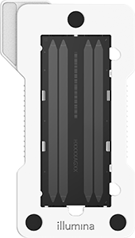



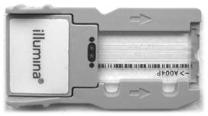
Platform choice
Options from Illumina
Pacbio > 10 kb*
HiSeq X/4000 | HiSeq 2500 |  | NextSeq 500 |  | MiSeq
6 Billion/400M | High: 4 Billion/250M | Rapid: 600M/300M | High: 400M | Mid: 130M | v3: 25M | v2: 15M
150 PE Human genome only | 36 SE 50 PE 100 PE 125 PE |  | 75 SE 75 PE 150 PE |  | 36 SE 25 PE 150 PE 300 PE

Slide 6
Replicates
Nature Methods 11, 879–880 (2014) doi:10.1038/nmeth.3091
Notes:
What is the budget?
http://www.genengnews.com/gen-articles/6-things-to-consider-before-your-next-gen-sequencing-project/4386/

Slide 7
Biological question
Genome assembly
Not a straight forward pipeline
Evolutionary Applications 7:9, 1026-1042 (2014) doi: 10.1111/eva.12178

Slide 8
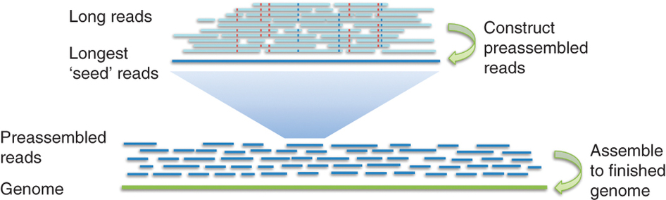
Biological question
Genome assembly
Size?
De novo?
Re-sequencing?
PacBio
Hybrid approach
Illumina
Illumina
PacBio
Evolutionary Applications 7:9, 1026-1042 (2014) doi: 10.1111/eva.12178
Nature Methods 10, 563–569 (2013) doi:10.1038/nmeth.2474

Slide 9
Biological question
Targeted sequencing
DNA protein interaction
Sequence variation
Methylation
Rearragements and Markers
Structure
Genome available
Get away with short reads
Illumina (TSCA)
NuGen (SPET)
Agilent (HALO)
Qiagen
Wafergen
Raindance
Agilent (Sureselect )
Roche Nimblegen
(EZ exome / CpGiant)
Swift Biosciences
BioO Scientific
Directed Genomics
pxlence
http://www.illumina.com/content/dam/illumina-marketing/documents/applications/ngs-library-prep/ForAllYouSeqMethods_v19.pdf

Slide 10
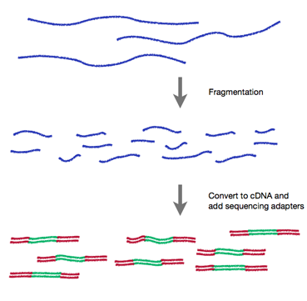

Biological question
RNA sequencing
cDNA synthesis
Strand-specific sequencing
Input RNA
Fragmented
RNA
DNA library
http://rnaseq.uoregon.edu/
Notes:
http://www.biomedcentral.com/1471-2164/13/734

Slide 11
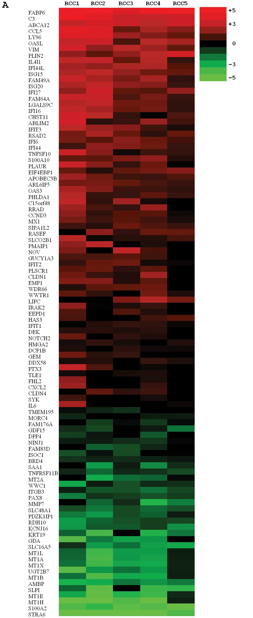
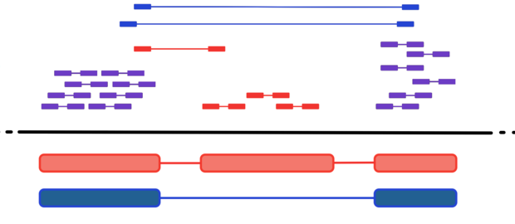
Biological question
RNA sequencing
Highly expressed known transcripts
Novel isoforms
Low expressed/rare transcripts
Aligned
Fragments
Genome
Isoform A
Isoform B
Int J Oncol. 2012 Sep;41(3):805-17. doi: 10.3892/ijo.2012.1543
http://cgrlucb.wikispaces.com/Isoform+Deconvolution+and+Unannotated+Species

Slide 12
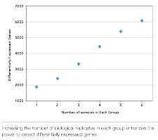
Biological question
RNA sequencing
replicates
http://www.illumina.com/Documents/products/technotes/technote_power_replicates.pdf

Slide 13
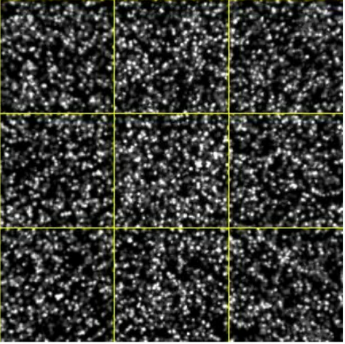
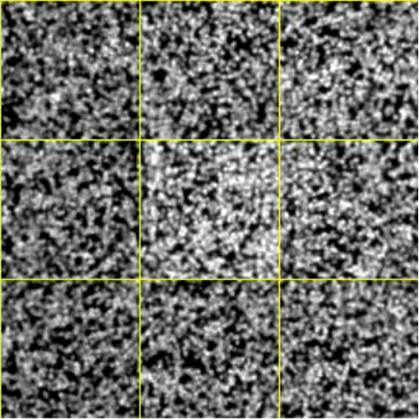
Biological question
Metagenomics
Amplicons
Low complexity
Genome/RNA sequencing
Amplicon sequencing

Slide 14
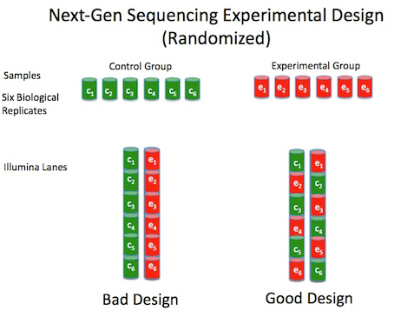
Illumina: Technical bias
Lane bias
Index/Barcode bias
Batch effect
Randomisation is key
http://nextgenseek.com/2012/10/tips-for-next-gen-sequencing-experiment-design-randomization/
Notes:
http://nextgenseek.com/2012/10/tips-for-next-gen-sequencing-experiment-design-randomization/

Slide 15
Case studies
Sequencing depth and coverage: key considerations in genomic analyses
Nature Reviews Genetics 15, 121–132 (2014) doi:10.1038/nrg3642
RNA-seq differential expression studies: more sequence, or more replication?
Bioinformatics (2013) doi: 10.1093/bioinformatics/btt688
An improved dual-indexing approach for multiplexed 16S rRNA gene sequencing on the Illumina MiSeq platform
Microbiome 2014, 2:6 doi:10.1186/2049-2618-2-6

Slide 16
Sequencing depth and coverage: key considerations in genomic analyses
HiSeq X
HiSeq 4000
Nature Reviews Genetics 15, 121–132 (2014) doi:10.1038/nrg3642
Notes:
Depth: The average number of times that a particular nucleotide is represented in a collection of random raw sequences.
Coverage: The average number of reads that align to, or "cover," known reference bases in the genome.

Slide 17
Sequencing depth and coverage: key considerations in genomic analyses
Sequencing depths for different applications
(Data from ENA/Illumina platform/2012-June 2013
Nature Reviews Genetics 15, 121–132 (2014) doi:10.1038/nrg3642
Notes:
Depth: The average number of times that a particular nucleotide is represented in a collection of random raw sequences.
Coverage: The average number of reads that align to, or "cover," known reference bases in the genome.

Slide 18
Sequencing depth and coverage: key considerations in genomic analyses
Staged sequencing for predicting sequencing requirements
Nature Reviews Genetics 15, 121–132 (2014) doi:10.1038/nrg3642
Notes:
Depth: The average number of times that a particular nucleotide is represented in a collection of random raw sequences.
Coverage: The average number of reads that align to, or "cover," known reference bases in the genome.

Slide 19
Sequencing depth and coverage: key considerations in genomic analyses
Representative read counts for location-based approaches
Nature Reviews Genetics 15, 121–132 (2014) doi:10.1038/nrg3642
Notes:
Depth: The average number of times that a particular nucleotide is represented in a collection of random raw sequences.
Coverage: The average number of reads that align to, or "cover," known reference bases in the genome.

Slide 20
RNA-seq differential expression studies: more sequence, or more replication?
Bioinformatics (2013) doi: 10.1093/bioinformatics/btt688

Slide 21
RNA-seq differential expression studies: more sequence, or more replication?
Cost efficiency for power to detect DE genes
Bioinformatics (2013) doi: 10.1093/bioinformatics/btt688

Slide 22
An improved dual-indexing approach for multiplexed 16S rRNA gene sequencing on the Illumina MiSeq platform
Dual-indexed 16S rRNA gene PCR amplification strategy with heterogeneity spacer primers for sequencing on the MiSeq platform
Microbiome 2014, 2:6 doi:10.1186/2049-2618-2-6

Slide 23
An improved dual-indexing approach for multiplexed 16S rRNA gene sequencing on the Illumina MiSeq platform
Quality and base composition assessment with old and new design
Microbiome 2014, 2:6 doi:10.1186/2049-2618-2-6

Slide 24
Cost and time efficient triple-index library preparation for ultra-multiplexed 16S rRNA sequencing
5’ Linker
Index 1 : 12bp
Heterogeneity Spacer : 0-7 bp
319F
PCR 1
V3V4
806R
Heterogeneity Spacer : 0-7 bp
Index 2 : 12 bp
5’ Linker
3’ Linker
TruSeq index 1 : 6 bp
PCR 2
V3V4
3’ Linker
HP11
Up to 259 bp
Sequencing
V3V4
6 bp
HP12
Up to 259 bp
HP10
Quality and base composition assessment with old and new design
Gilfillan, et al. In prep

Slide 25
Finally….
Contact NSC (post@sequencing.uio.no) for sequencing advice

